Slide 1
MENDELU 2022
Tomas Cejka(CJ), Róbert Oravec - STRV

Slide 2
STRV X MENDELU
History
Academy
2 weeks
Networking
Questions
🖐

Slide 3
NETWORKING

Slide 4
NETWORKING
Async
Remote server
Authentication
Request creation
Error handling
Parsing data

Slide 5
NETWORKING
REST
SOAP
GraphQL

Slide 6

QUESTION?

Slide 7

REST
01

Slide 8

WHAT IS REST ?
Architectural styles and approach to communications used in web services development
HTTP
Client - server architecture
Statelessness
Cacheability
Layered system
Uniform interface
Notes:
https://www.techtarget.com/searchapparchitecture/definition/RESTful-API

Slide 9
REST
Client - server
Independent
Async
Secured
Limitations
Notes:
https://www.techtarget.com/searchapparchitecture/definition/RESTful-API

Slide 10
REST
Statelessness
Standalone
“Session”
Websocket
Previous packets knowledge
Performance
Notes:
https://www.techtarget.com/searchapparchitecture/definition/RESTful-API

Slide 11
REST
Cacheability
Intermediaries & clients
Implicit & explicit
Scalability & performance
Notes:
https://www.techtarget.com/searchapparchitecture/definition/RESTful-API

Slide 12
REST
Layered system
Server & intermediaries
Proxy
Load balancer
Scalability & security
Notes:
https://www.techtarget.com/searchapparchitecture/definition/RESTful-API

Slide 13
REST
Uniform interface
Resource identification in request
Different representation
Resource manipulation
Self-descriptive messages
MediaType
Hypermedia
Dynamic links to all resources
Notes:
https://www.techtarget.com/searchapparchitecture/definition/RESTful-API

Slide 14
REST
Cacheability
Intermediaries & clients
Implicit & explicit
Scalability & performance
Notes:
https://www.techtarget.com/searchapparchitecture/definition/RESTful-API

Slide 15
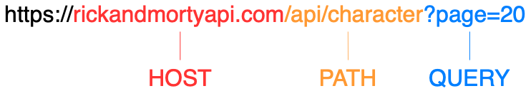
ANATOMY OF URL

Slide 16
HTTP METHODS
GET
POST
PUT
PATCH
DELETE
Notes:
https://developer.mozilla.org/en-US/docs/Web/HTTP/Methods

Slide 17
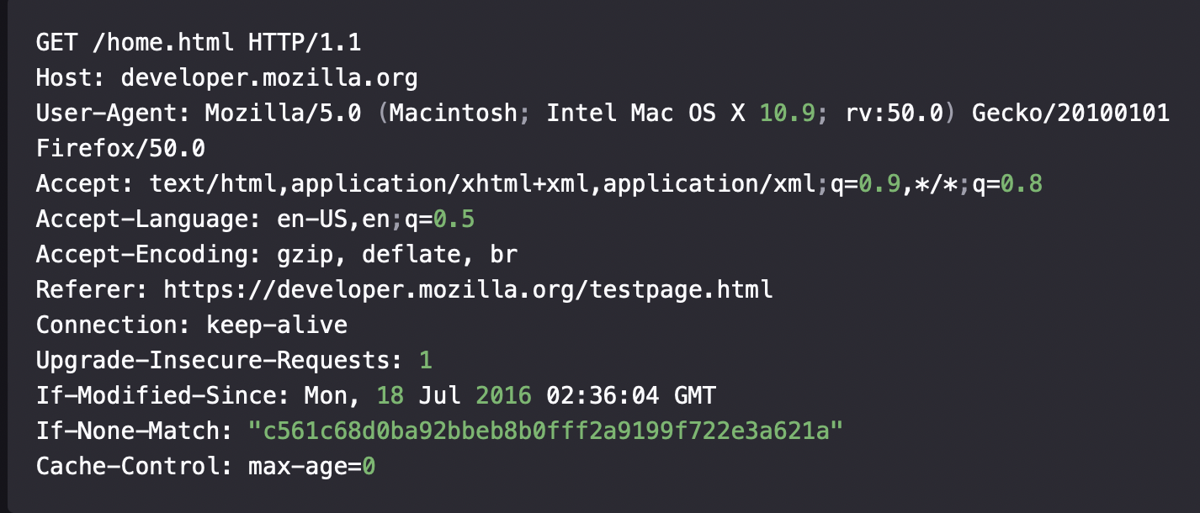
HTTP HEADERS
Content-type
Accept
Content-Encoding
Cache-control
Authorization
Notes:
https://developer.mozilla.org/en-US/docs/Web/HTTP/Headers

Slide 18
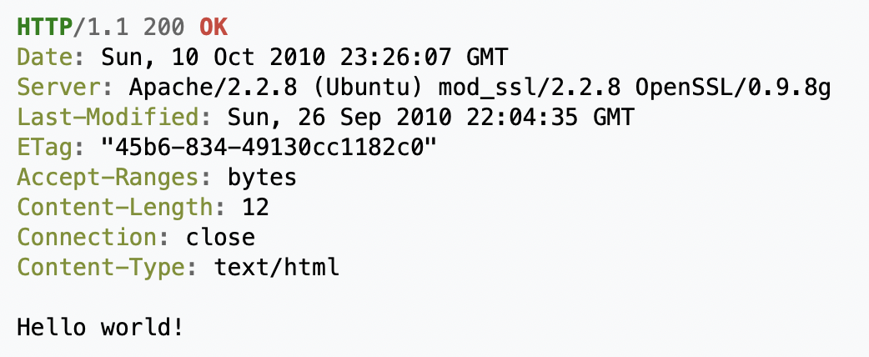
HTTP BODY
Application/x-www-form-urlencoded
Multipart/form-data
Text/plain
Application/json

Slide 19
HTTP RESPONSE STATUS CODES
Information responses (100 - 199)
Successful responses (200 - 299)
200 - everything went ok
201 - resource created using for example POST or PUT method
Redirection responses (300 - 399)
Client error responses (400 - 499)
400 - bad request
401 - unauthorized
403 - forbidden
404 - not found
Server error responses (500 - 599)
Notes:
https://developer.mozilla.org/en-US/docs/Web/HTTP/Status

Slide 20
HTTP RESPONSE TYPES
XML
JSON
YAML
HTML
Binary

Slide 21
JSON
Data interchange object
Simple format
Constraints
Readable for human
Basic data types
Small
Notes:
https://developer.mozilla.org/en-US/docs/Web/HTTP/Status

Slide 22
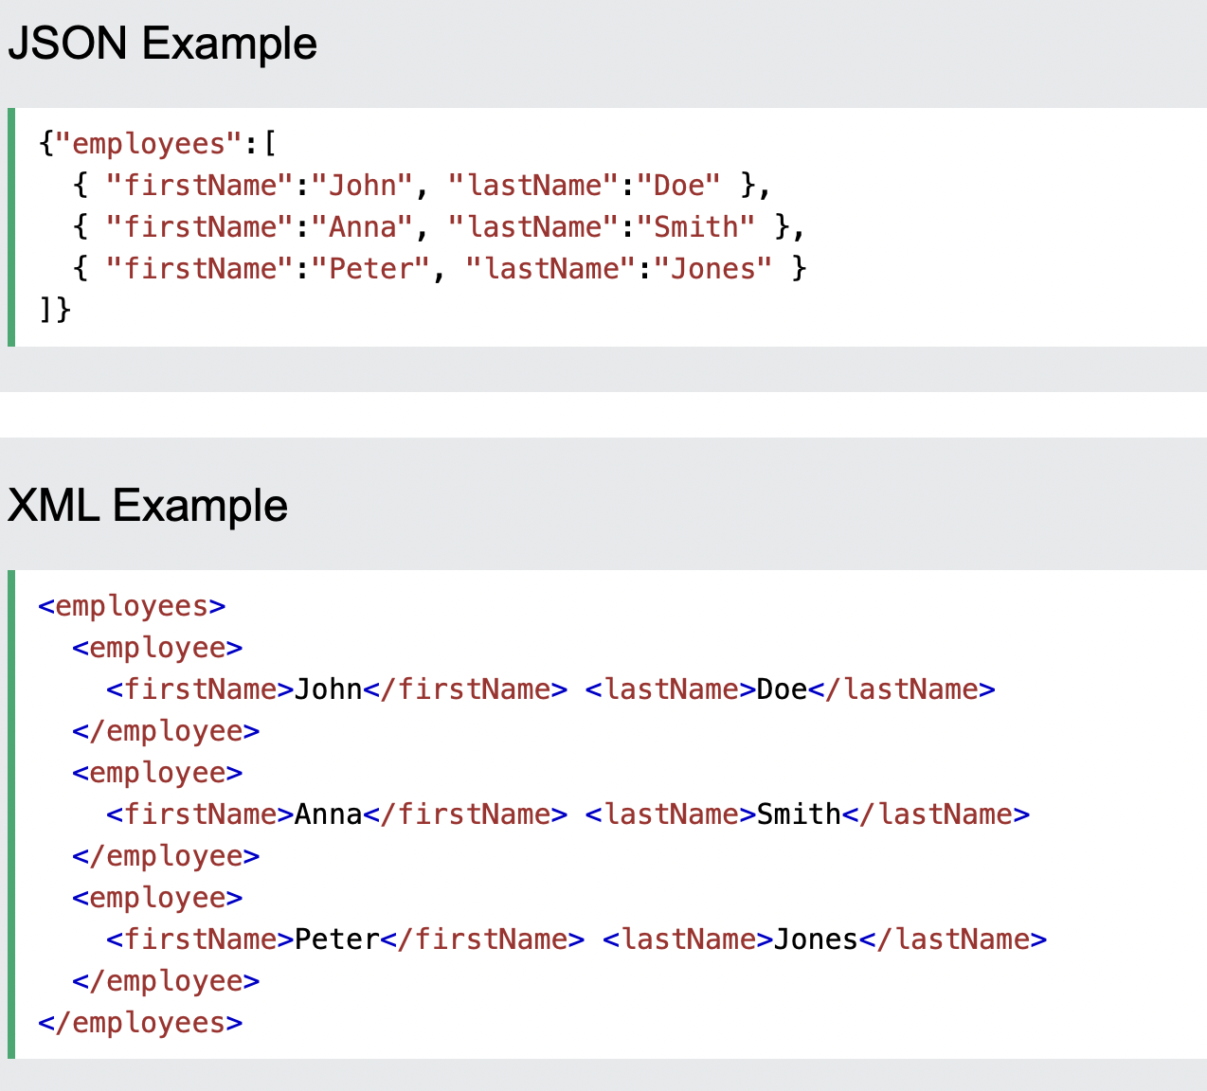
JSON VS XML
Notes:
https://developer.mozilla.org/en-US/docs/Web/HTTP/Status

Slide 23

QUESTION?

Slide 24
AUTHENTICATION
Basis // Authorization: Basic bG9sOnNlY3VyZQ==
Bearer // Authorization: Bearer <token>
API key // Authorization: Apikey 1234567890abcdef
Oauth
Authorization server
Access token + Refresh token
Facebook, Google, Apple sign in
JWT, OpenID

Slide 25
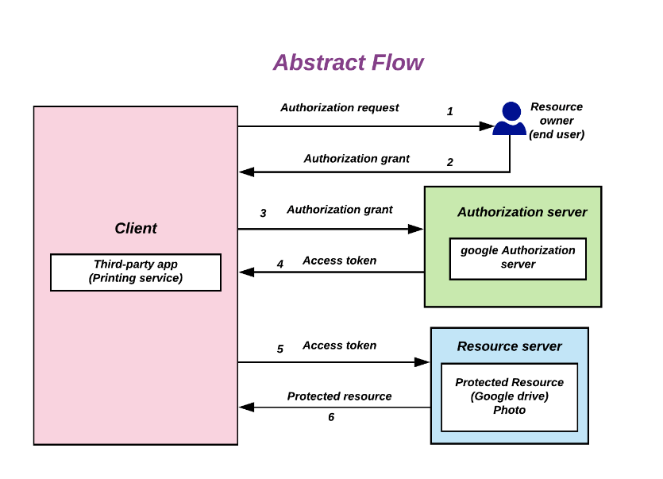
OAUTH

Slide 26

QUESTION?

Slide 27

EXAMPLES
02
Notes:
https://www.postman.com

Slide 28

REST + IOS
03

Slide 29


Slide 30

URLSESSION
Downloading data from and uploading data to endpoints
Singleton instance can be accessed through shared static property
Configurable
Ephemeral session
Background session
Data tasks
Upload tasks
Download tasks
WebSocket tasks
Alamofire + Moya
Notes:
https://developer.apple.com/documentation/foundation/urlsession
https://www.raywenderlich.com/3244963-urlsession-tutorial-getting-started

Slide 31

NETWORK LAYERS IN IOS APP

Slide 32
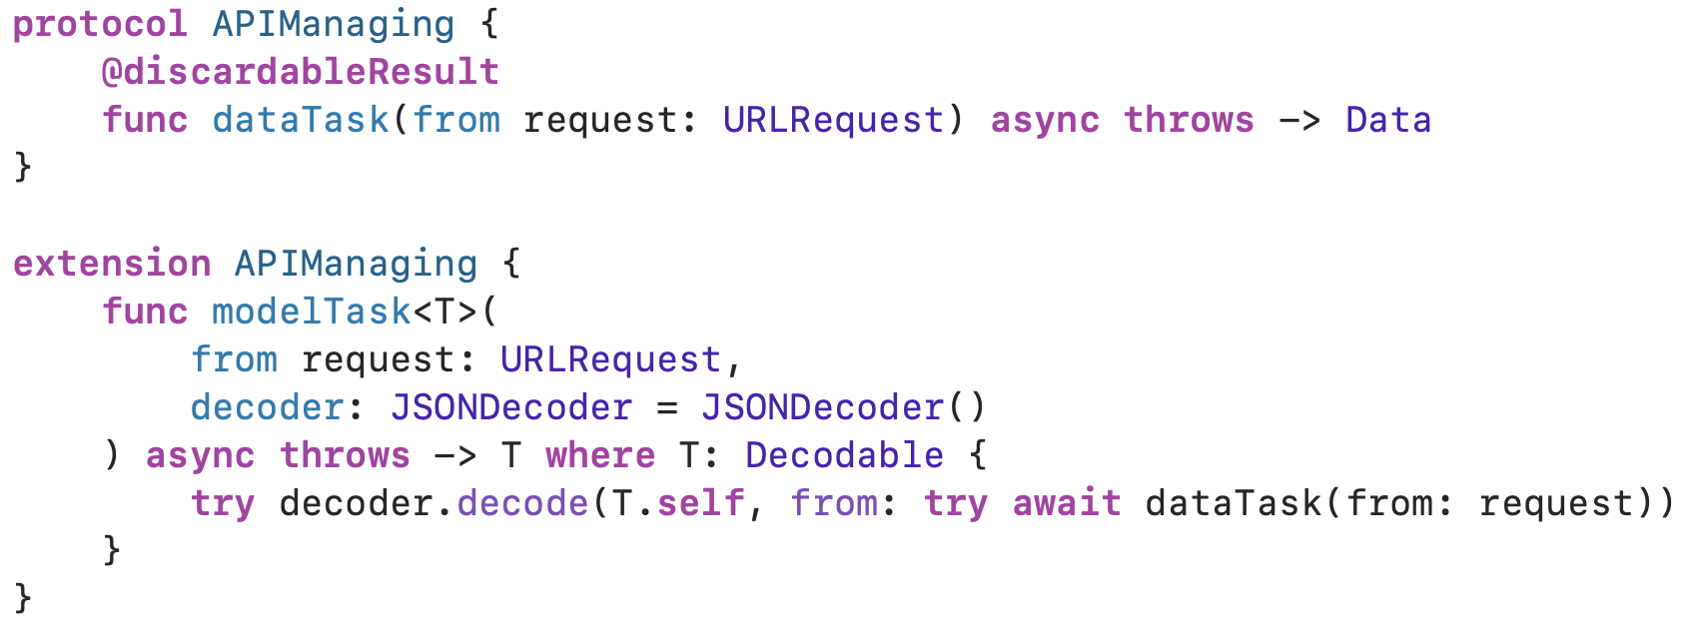
API MANAGER
uses URLSession to call finalized network request
authentication, automatic refresh token
wrong status code responses

Slide 33
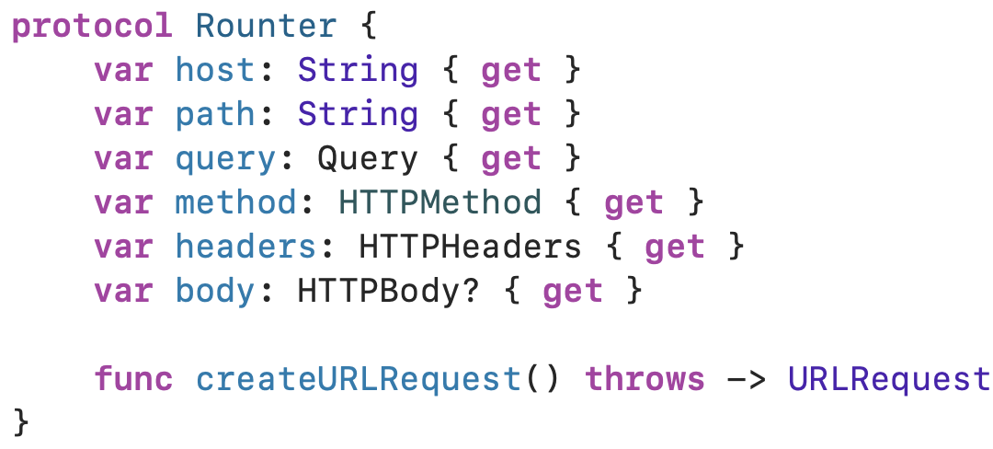
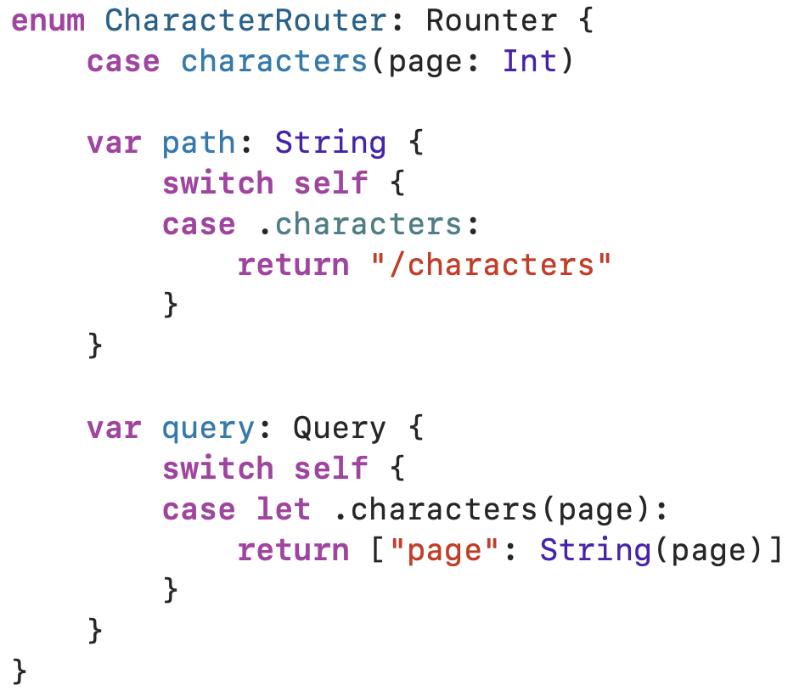
ROUTER
creates URLRequest

Slide 34
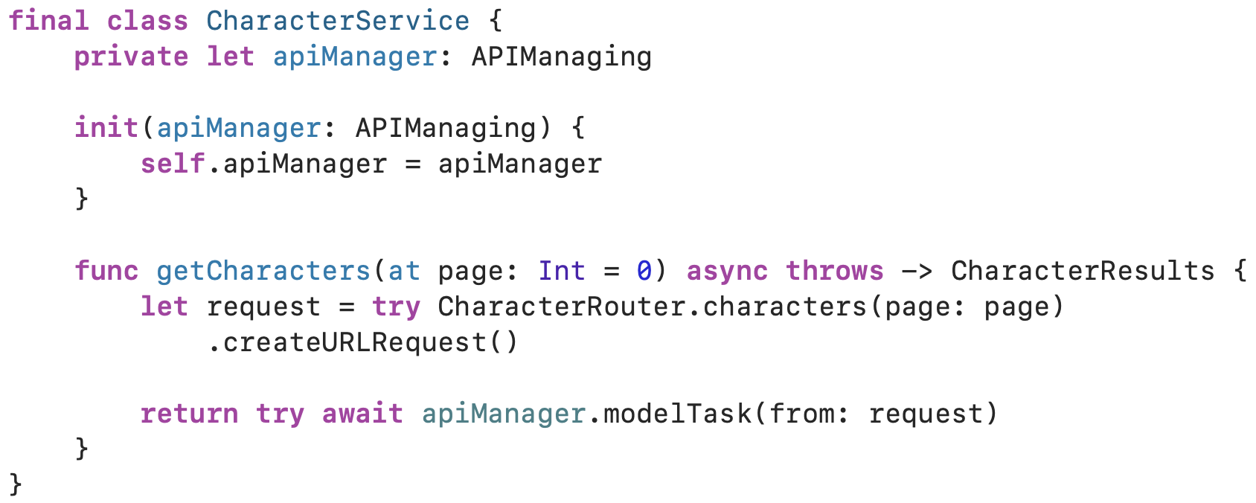
USE CASE / SERVICE
Creates request using Router and then call it with APIManager

Slide 35
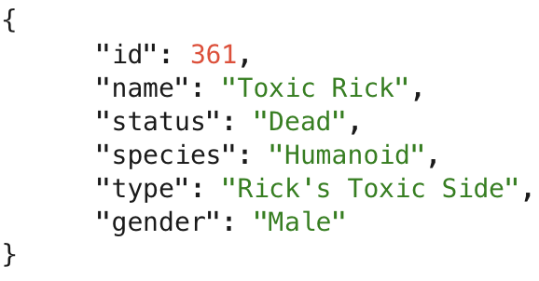
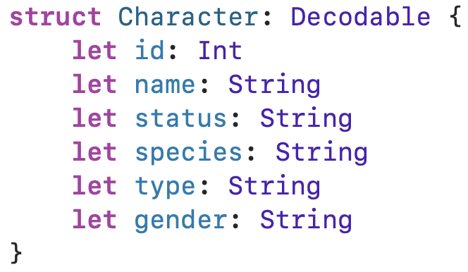
CODABLE
Protocol used to convert itself to and out of external representation (for example JSON)
Codable = Encodable & Decodable
Introduced in Swift 4
JSONEncoder, JSONDecoder
CodingKey
Notes:
https://developer.apple.com/documentation/swift/codable

Slide 36
REST PLAYGROUND
04

Slide 37

GRAPHQL
05

Slide 38

WHAT IS GRAPHQL ?
A query language for APIs
It has been used by Facebook applications since 2012
You can query only the data you need
Allows you to get many resources in single request
Has its own language (GraphQL Schema language)
Notes:
https://graphql.org

Slide 39



QUERIES, MUTATIONS & SUBSCRIPTIONS
Queries are used to query data
Basically selecting fields on objects, you don’t have to get everything
Mutations are used to update data
You can imagine them as POST + PUT requests in REST API
Subscriptions are used to get continuous data updates
Think about them as WebSockets
Notes:
https://graphql.org/learn/queries/ https://graphql.org/blog/subscriptions-in-graphql-and-relay/

Slide 40
GRAPHQL PLAYGROUND
06
Notes:
https://rickandmortyapi.com/graphql - Opration name - Fields - Arguments - Optional arguments
- Aliases - Fragments

Slide 41
GRAPHQL + IOS
07
Notes:
https://rickandmortyapi.com/graphql

Slide 42

Apollo
Unifies GraphQL across applications
CodeGen
Supports SQL and in memory cache
Apollo Kotlin multiplatform
Notes:
https://www.apollographql.com
https://www.apollographql.com/docs/ios

Slide 43
GRAPHQL PLAYGROUND
08
Notes:
Show how does codegen work
Create GraphQL client with different configurations
Fetch query from Rick and Morty

Slide 44

QUESTIONS

Slide 45
THANK YOU!
www.strv.com / @strvcom

Slide 46
1) Get the official STRV fonts at brand.strv.com before creating a presentation
2) Keep the presentation structure described on Slide 3
2) Edit content only, not formatting or layout
3) Don’t over-do it with GIFs
4) Send your finished presentation to the Design team for a review
5) Presentations without a review should not be shared publicly

Slide 47
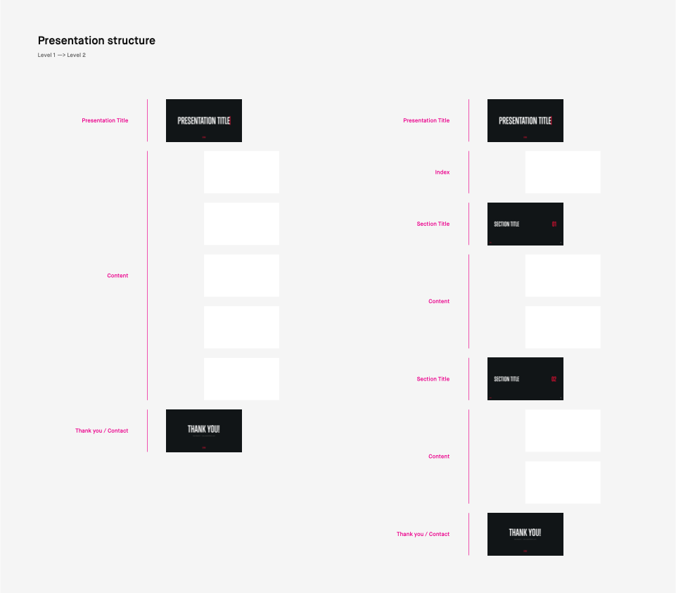

Slide 48
PRESENTATION TITLE

Slide 49
PRESENTATION TITLE

Slide 50
PRESENTATION TITLE
[Name][Surname], [Position] at STRV

Slide 51
PRESENTATION TITLE WITH TWO LINES

Slide 52
PRESENTATION TITLE
WITH TWO LINES
[Name][Surname], [Position] at STRV

Slide 53
SECTION TITLE

Slide 54
SECTION TITLE
01

Slide 55
SECTION TITLE
WITH TWO LINES
01

Slide 56
TEXT SLIDES

Slide 57
SLIDE TITLE
This is the most basic text content slide int, or use a full sentence to highlight something
Go straight to the point, or use a full sentence to highlight something like this
Use only one-line texts, beware of splitting text into two rows
Don’t overload text screen too much, 6-8 points are enough
You can also use second level
Describe more stuff more in detail if necessary

Slide 58

SLIDE TITLE
Don’t let this text overlay your image
Always choose the image wisely
Try to not split your point into two rows
6-8 points are enough

Slide 59
SLIDE TITLE
75%
34K
3
Client leads increase
Daily Active Users
Total Devs (mo)

Slide 60
SLIDE TITLE
You can also start your content screen with a paragraph before you introduce a couple of
bullet points. But stick with 2-3 rows top here so the text isn’t too long.
Now you can use bullet point list
Points out some highlights
And use 3-5 points max.

Slide 61
SLIDE TITLE
First section subtitle
Use this in case you need to have some sections
Keep section titles short and clear
2-3 points are enough
Second section subtitle
You can also use 2-3 points in this section
This slide is nicely structured
With 6 points in total

Slide 62
SLIDE TITLE
First section subtitle
You place two list next to each other
Make sure there is not too much text
It does not look that pretty
Only use this when necessary
Otherwise choose a simple option
Second section subtitle
You place two list next to each other
Make sure there is not too much text
It does not look that pretty
Only use this when necessary
Otherwise choose a simple option

Slide 63
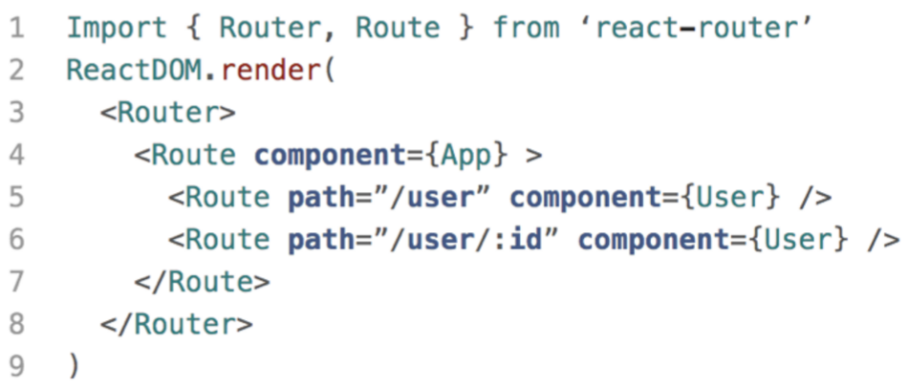
SLIDE TITLE
Describe your code here
I have no idea what this router shit means

Slide 64
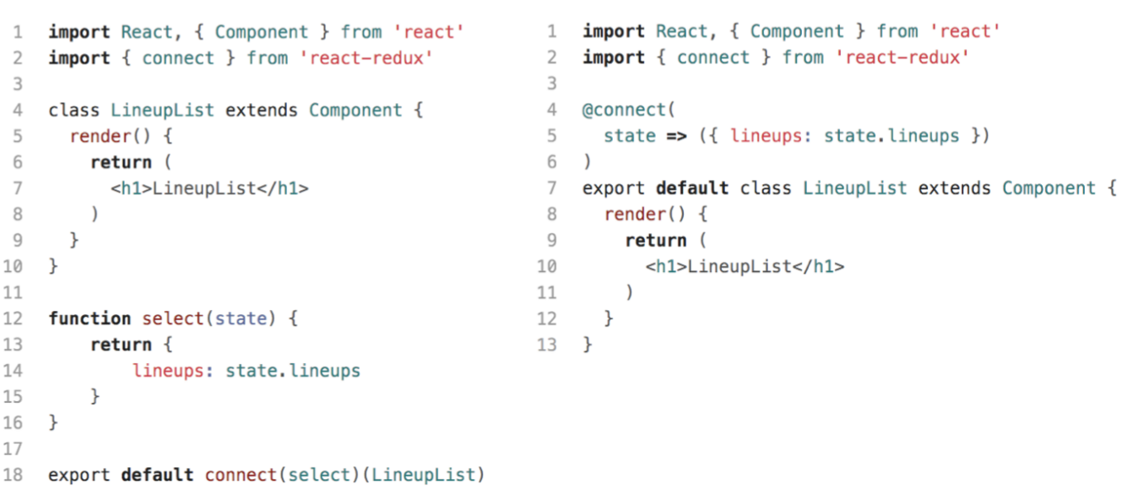
SLIDE TITLE

Slide 65
CONTENT SLIDES

Slide 66


Slide 67


Slide 68


Slide 69
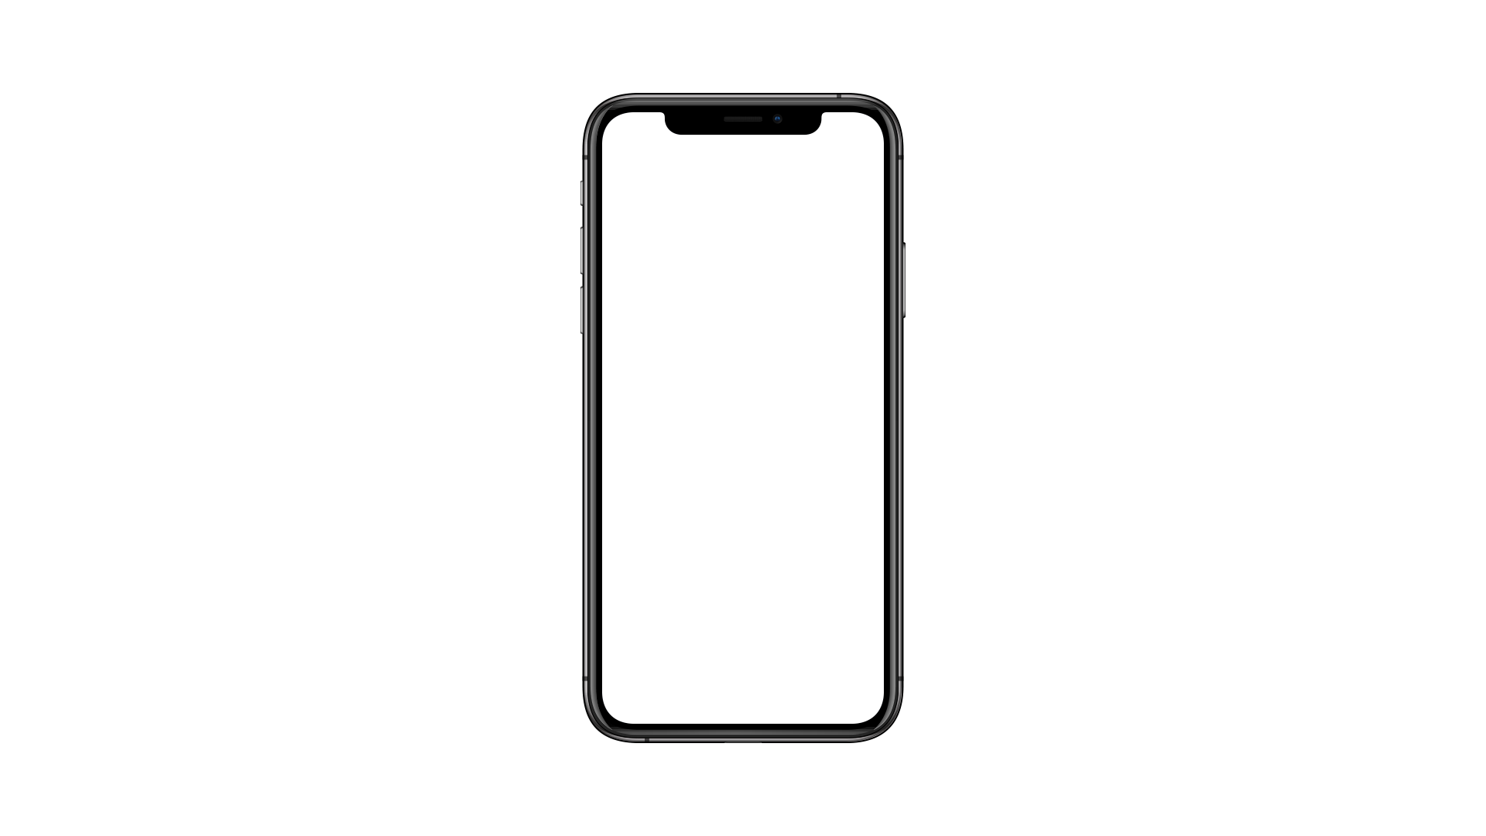
iPhone X - Black
364 x 790 px

Slide 70
iPhone X - Black
364 x 790 px
iPhone X - Black
364 x 790 px

Slide 71
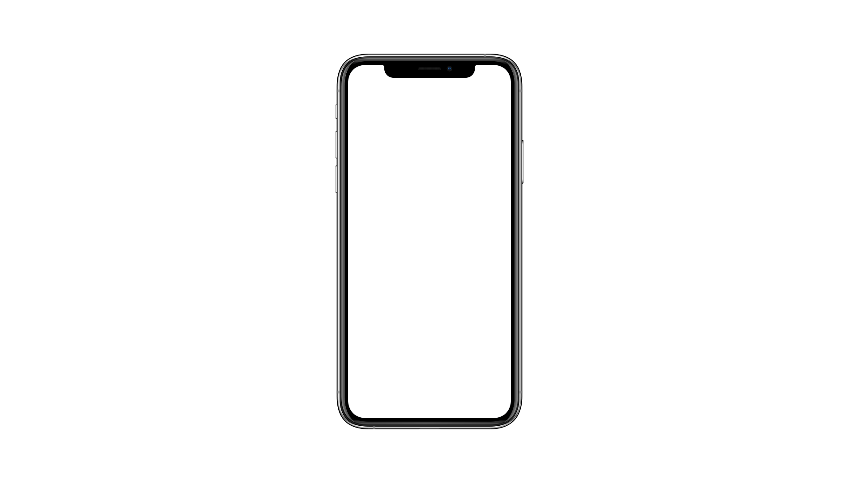
iPhone X - Silver
364 x 790 px

Slide 72
iPhone X - Silver
364 x 790 px
iPhone X - Silver
364 x 790 px

Slide 73

iPad Pro 2018 - Black
1024 x 768 px

Slide 74

iPad Pro 2018 - Silver
1024 x 768 px

Slide 75
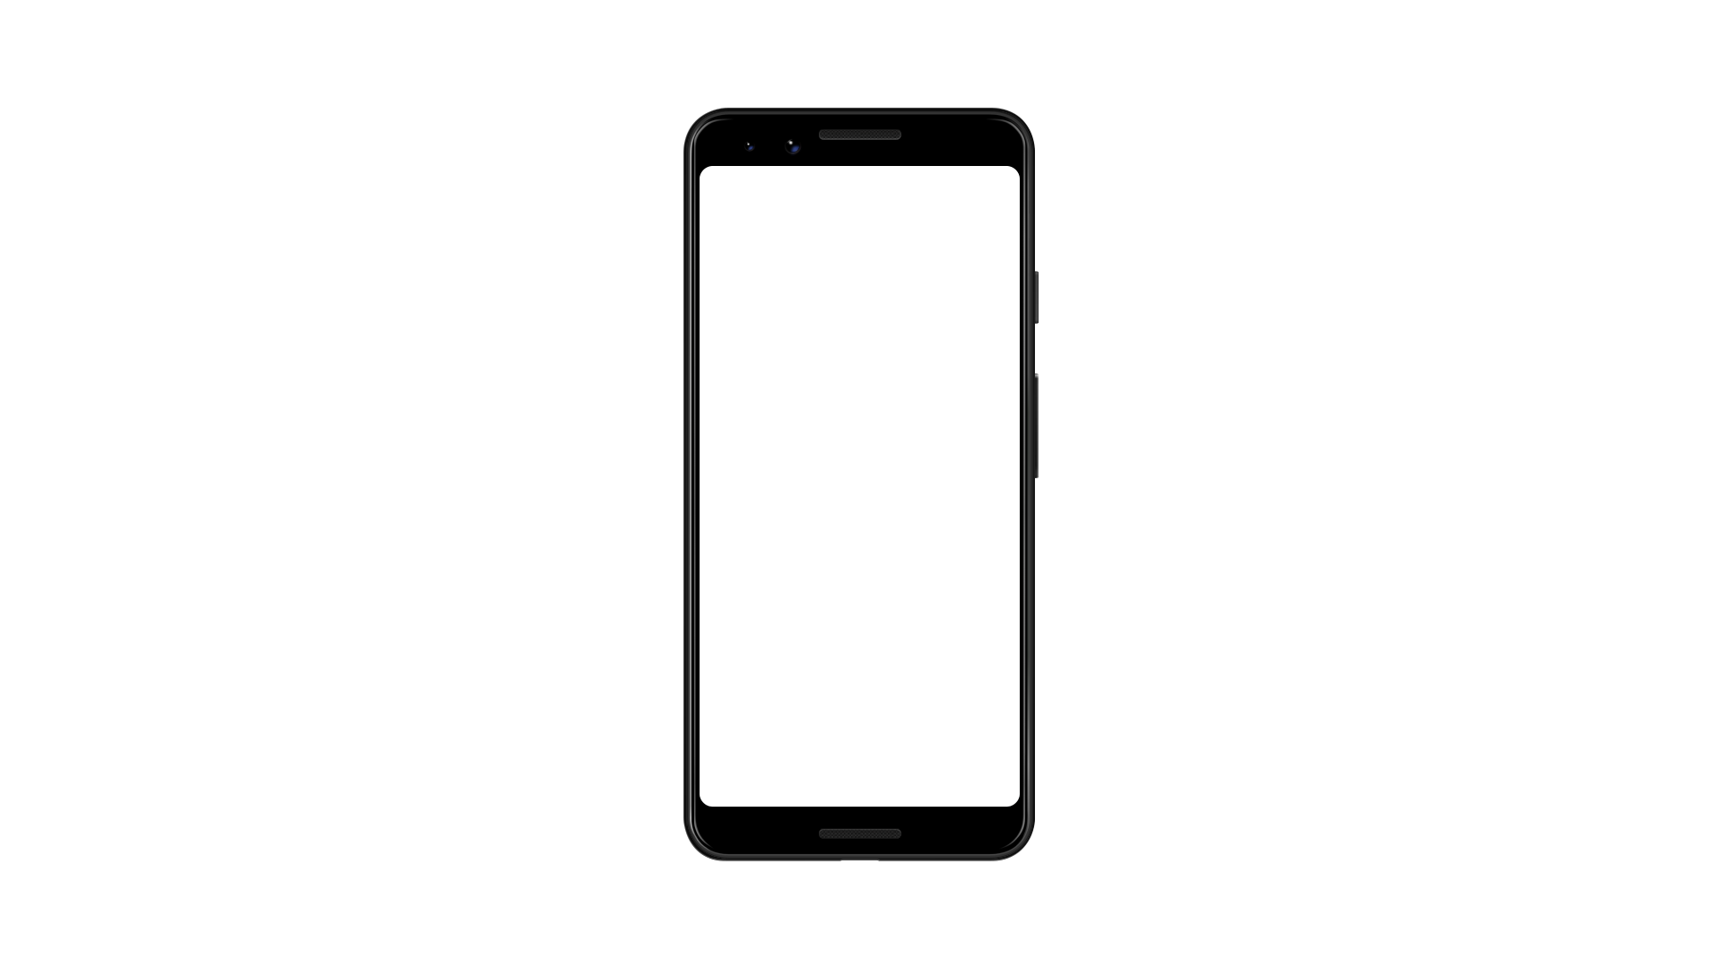
Google Pixel 3 - Black
357 x 714 px

Slide 76
iPad Pro 2018 - Black
1024 x 768 px
iPad Pro 2018 - Black
1024 x 768 px

Slide 77

iPad Pro 2018 - Silver
1024 x 768 px

Slide 78
iPad Pro 2018 - Silver
1024 x 768 px
iPad Pro 2018 - Silver
1024 x 768 px

Slide 79
“Creativity is putting your
imagination to work, and it’s
produced the most extraordinary
Results in human culture.”
Ken Robinson, Designer at STRV

Slide 80
FINISH

Slide 81
THANK YOU!
Ales Nesetril / ales.nesetril@strv.com

Slide 82
ADDITIONAL SLIDES

Slide 83

ABOUT STRV
Design and development of digital solutions for the
bravest startups and Fortune 500 companies.
Software design & engineering team
Offices in the US and Europe
More than 190 experts on our side
Visit us at www.strv.com
Follow us at @strvcom

Slide 84
ONE-LINE MESSAGE

Slide 85
ONE-LINE MESSAGE

